Slide 1

Limitless Connection at the Cost of Meaningful Relationships

Slide 2

1,000,000+

Slide 3


Robin Dunbar
https://en.wikipedia.org/wiki/Robin_Dunbar

Slide 4
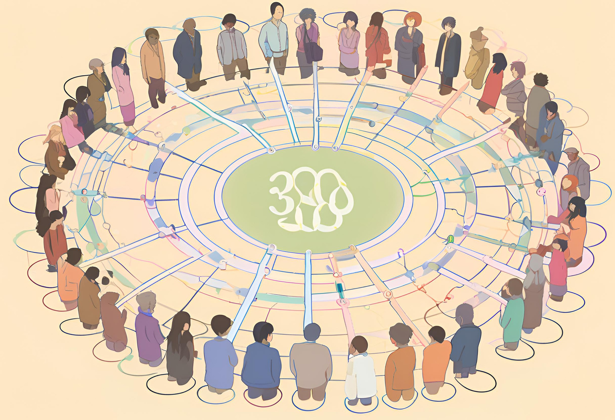
150

Slide 5
How many meaningful connections can you truly maintain?

Slide 6


Social media platforms

Slide 7

COVID-19

Slide 8

https://www.kl.ac.at/en
Mental well-being

Slide 9




Mental well-being

Slide 10



Body Language
Voice Pitch
Eye Gaze

Slide 11
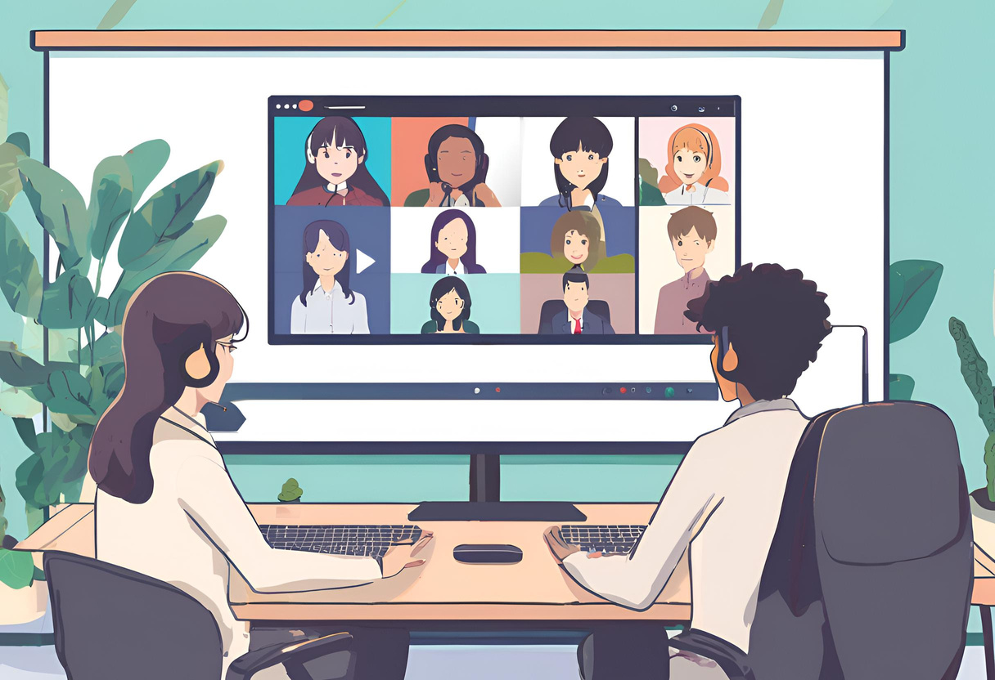
Video Conferencing

Slide 12


Slide 13
Are you creating and maintaining healthy, significant relationships?
or
Are you simply pacifying yourself behind a screen?

